Slide 1
Impact of Wikipedia on Market Information Environment: Evidence on Management Disclosure and Investor Reaction
Sean Xin Xu, Xiaoquan (Michael) Zhang
Presenter: Rongyang Ma 2025/03/16

Slide 2
Introduction
Firm Information:
Quantified information: financial data
Qualitative information: textual description
Information Disclosure:
Compulsory disclosure: SEC sets official announcement dates when firms must disclose performance
Management disclosure: voluntary disclosures before the compulsory data
Why managers choose to withhold or release bad information?
Withholding perspective:
when there is bad news, managers withhold to wait for more favorable news
available when firm information is paque to investors
Preemption perspective:
when the market holds an overly optimistic expectation, managers will release information promptly to adjust
important for managers’ reputation, litigation risk, smooth stock price change

Slide 3
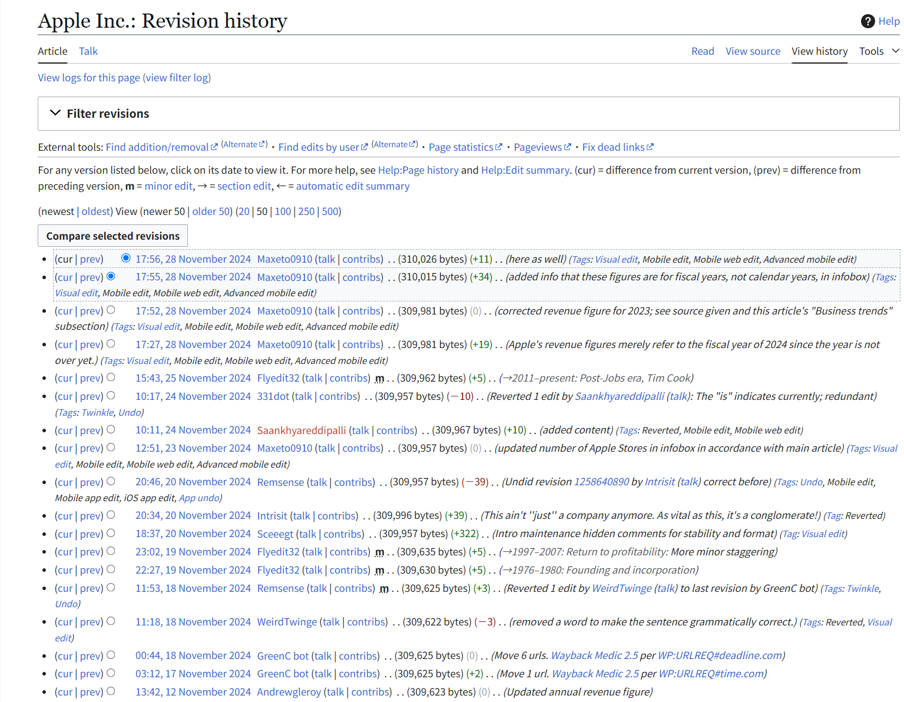
Introduction
Investors’ Information Environment:
Quantified data: analyst forecast, financial statements
Qualitative data: journalist, newspaper, social media
Wikipedia:
A good tool to aggregate information
Keep a good record of significant events for public firms
Make investors’ information environment more opaque
RQ:
Does Wikipedia’s aggregation of qualitative information affect how management disclosure is conditioned on quantified information in the market about firm earnings?
How would Wikipedia change investors' reactions when managers disclose unfavorable news

Slide 4
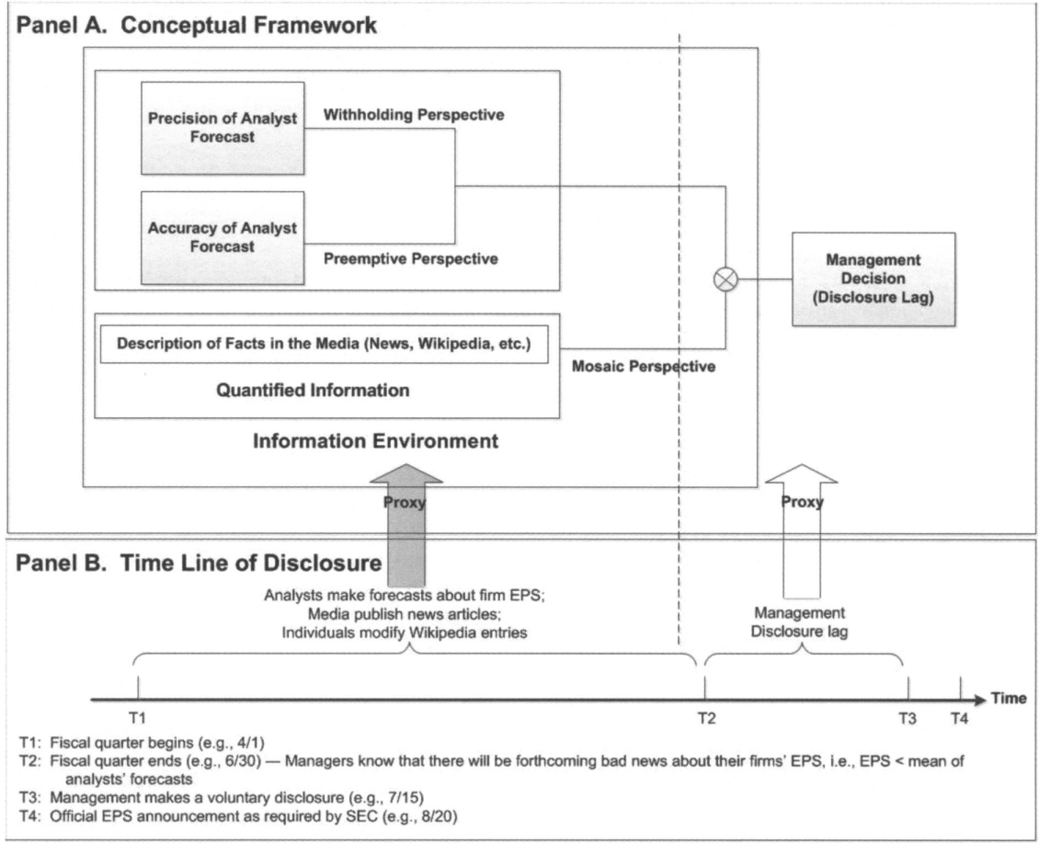
Introduction

Slide 5
Theoretical Basis & Hypothesis
Measure of Voluntary Disclosure:
Focus on bad news
Disclosure lag: the number of days between the end of a fiscal quarter and the date when managers voluntarily disclose bad news
Prior Study:
Focus on quantified information environment: analysts’ forecast dispersion and bias
Dispersion: proxy for market uncertainty
give managers an information advantage to keep silent
withholding perspective: disclosure lag is positively related to dispersion
Bias: proxy for difference between true firm performance and quantified forecast
Specifically, only focus on negative earnings surprise
preemption perspective: disclosure lag is negatively related to bias

Slide 6
Theoretical Basis & Hypothesis
Role of Wikipedia:
Aggregate a comprehensive information set about a firm
Weaken the information advantage of manager
May moderate the relationship between management disclosure and analyst forecast
H1: Information aggregation on Wikipedia weakens the relationship between analyst dispersion and management disclosure lag
Establish a more accurate expectation of firm earnings for investors
Alleviate managers’ concerns about overly optimism
H2: Information aggregation on Wikipedia weakens the relationship between analyst bias and management disclosure lag
A significant relationship between market reaction and unexpected earnings surprise (because of forecast bias)
More negative bias, more negative reaction
H3: Information aggregation on Wikipedia weakens the relationship between analyst bias and investor reaction to disclosure

Slide 7

Methodology
Measure:
DV:
Disclosure lag
Investor reaction: cumulative abnormal returns (CAR) around the disclosure date
IV:
Bias: difference between mean of forecast and the firm’s actual EPS (earnings per share)
Dispersion: standard deviation of forecasts
Information aggrgation: Wikipedia modifications (MikiMOD), the number of modifications about a firm in a quarter
Model Specification:
DV is far from normal distribution
Cox proportional hazard regression model

Slide 8


Methodology
Model Specification:
DV is far from normal distribution
Cox proportional hazard regression model
$h(t)$: harzard rate, the probability of incidence for the event (voluntary disclosure) at time t
$h_{0}(t)$: a benchmark harzard rate at time t when X = 0
Controls:
Firm risk: S.D. of earnings across the 8 previous fiscal quarters
Firm size, industry
Fiscal quarter
News coverage, news content (positive / negative words)

Slide 9
Methodology
Data Collection:
Management disclosure data: First Call Historical Database (FCHD)
Editing history data: crawl from Wikipedia
Firm data: CRSP
News-coverage data: Lexis-Nexis
2001/3/21 – 2006/05/19
8,789 registered users and 5,450 unregistered users contributing 77,921 modifications on Wikipedia firm entries
96 public firms with 161 disclosures

Slide 10
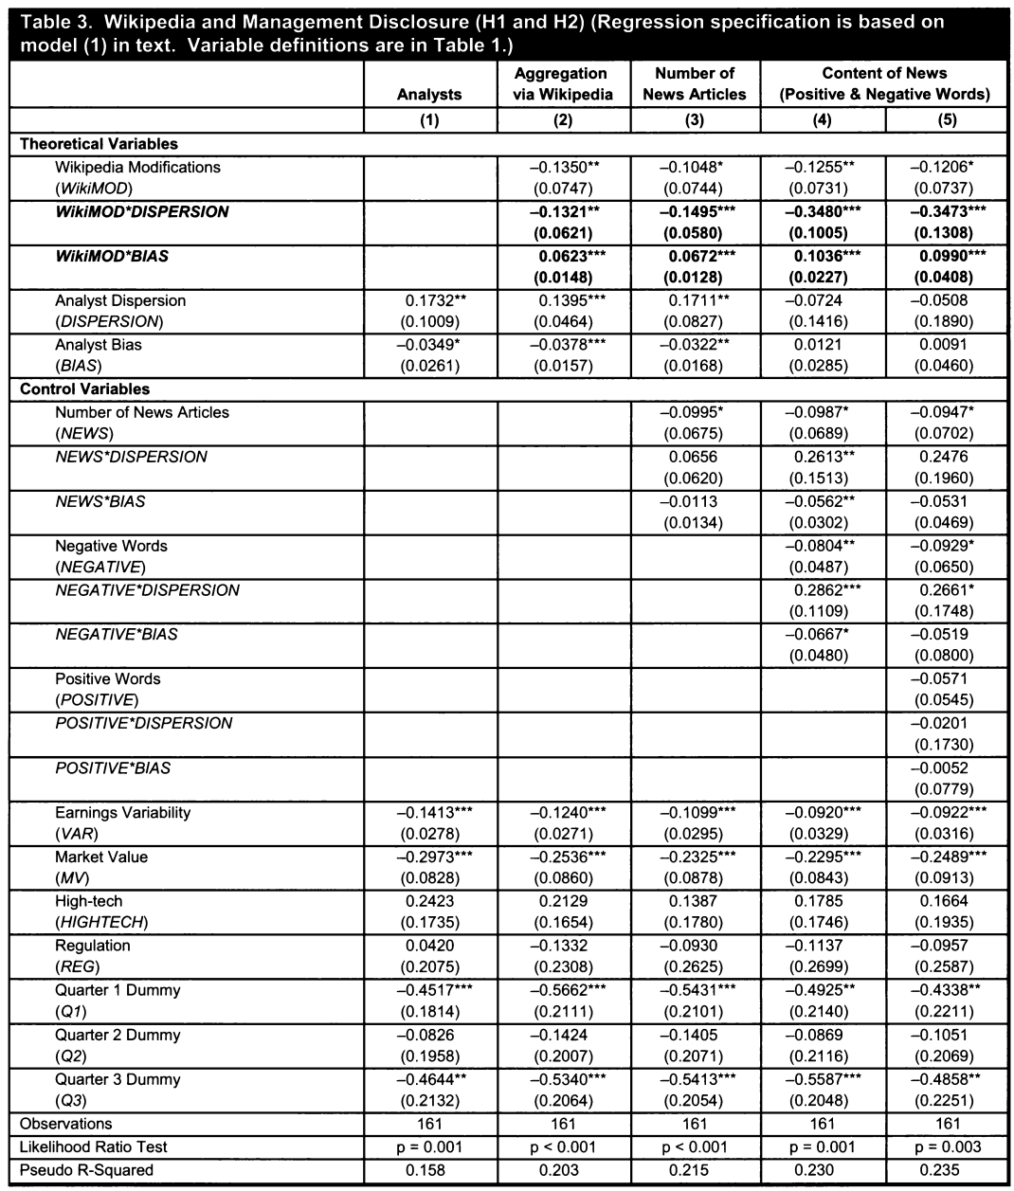
Result

Slide 11
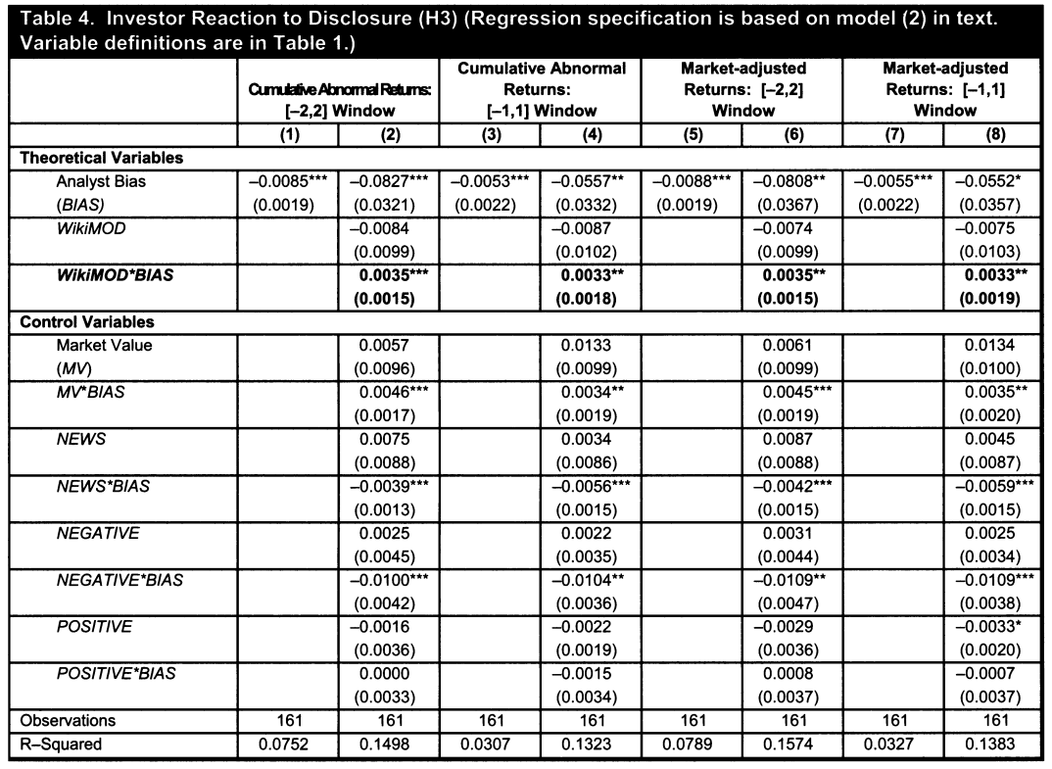
Result
Robustness Check:
Alter CAR windows
Replace CAR with market-adjusted returns

Slide 12
Discussion
Possible Endogeneity of WikiMOD:
Managers’ self-editing behavior on Wikipedia
Something influence managers’ self-editing and their disclosures
Alternative channels:
Alternative information channel that influences Wikipedia modifications and disclosure lags
Solution:
Introduce two possible IVs

Slide 13
Discussion
An alternative Explanation:
Firm visibility is correlated with MikiMOD and may influence management disclosure
Proxies for visibility:
Market value
Profitability (ROA)
Firm age
Advertising expenditure
Media coverage, Google’s Search Volume Index (investor attention)
NYSE listing, institutional ownership, anlyst following

